Slide 1






dayofclimate.mit.edu
The Systems That Shape Climate Change
Grades 8-12+
All curriculum materials are licensed
under a Creative Commons Attribution- NonCommercial 4.0 International License.

Slide 2
How do communities
navigate complex change?
How do we study
system change in the making?

Slide 3
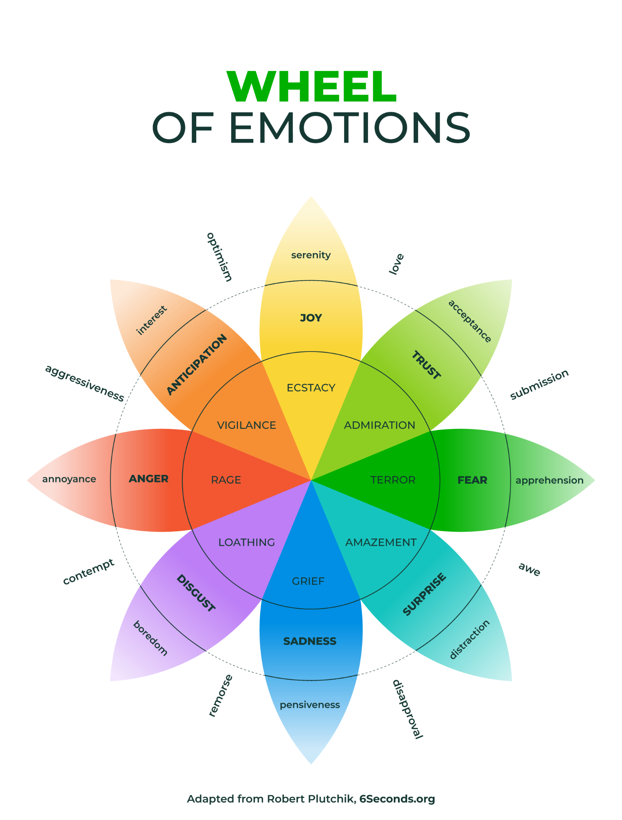
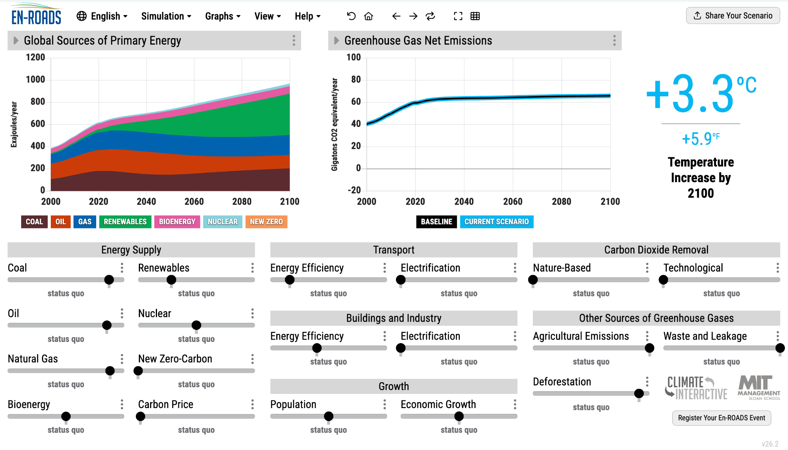
dayofclimate.mit.edu
All curriculum materials are licensed
under a Creative Commons Attribution- NonCommercial 4.0 International License.

Slide 4
dayofclimate.mit.edu
How can game- based facilitation of the En-ROADS simulator
develop learners’ understanding
of climate systems?
All curriculum materials are licensed
under a Creative Commons Attribution- NonCommercial 4.0 International License.

Slide 5
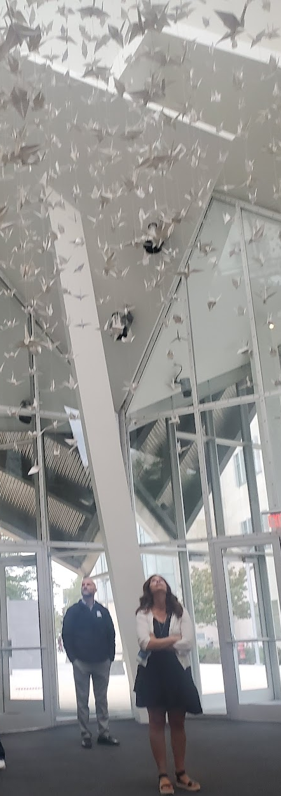
systems sensing
+
systems thinking
= systems awareness
Our ability to sense and understand the complexity of interconnected elements within a given system and discern our capacity to enact change within that interdependence.
Notes:
Contributing to the field of awareness-based systems change
See the work of Meadows, Senge, Koenig, Scharmer, Pomeroy, Boell.

Slide 6
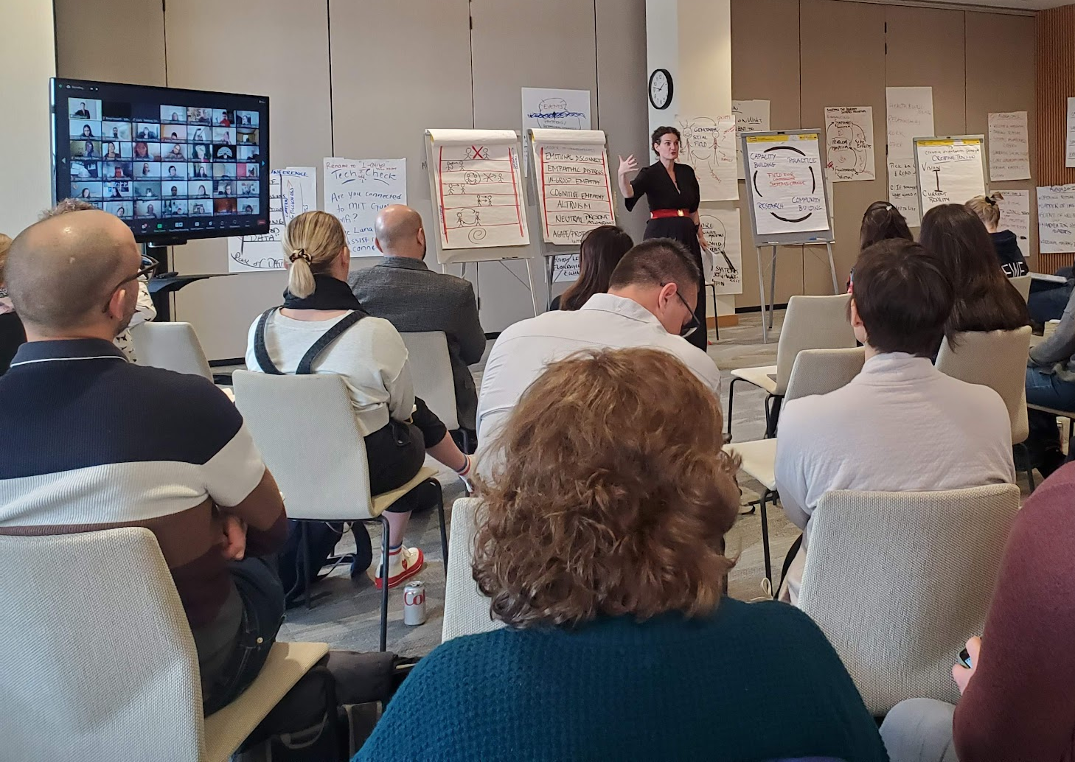
How we think about systems change
How do communities navigate complex sustaining change across interconnecting systems of:
self: personal, emotional, individual
relational: self and others
collective: the larger societal, ecological, and technological realities

Slide 7
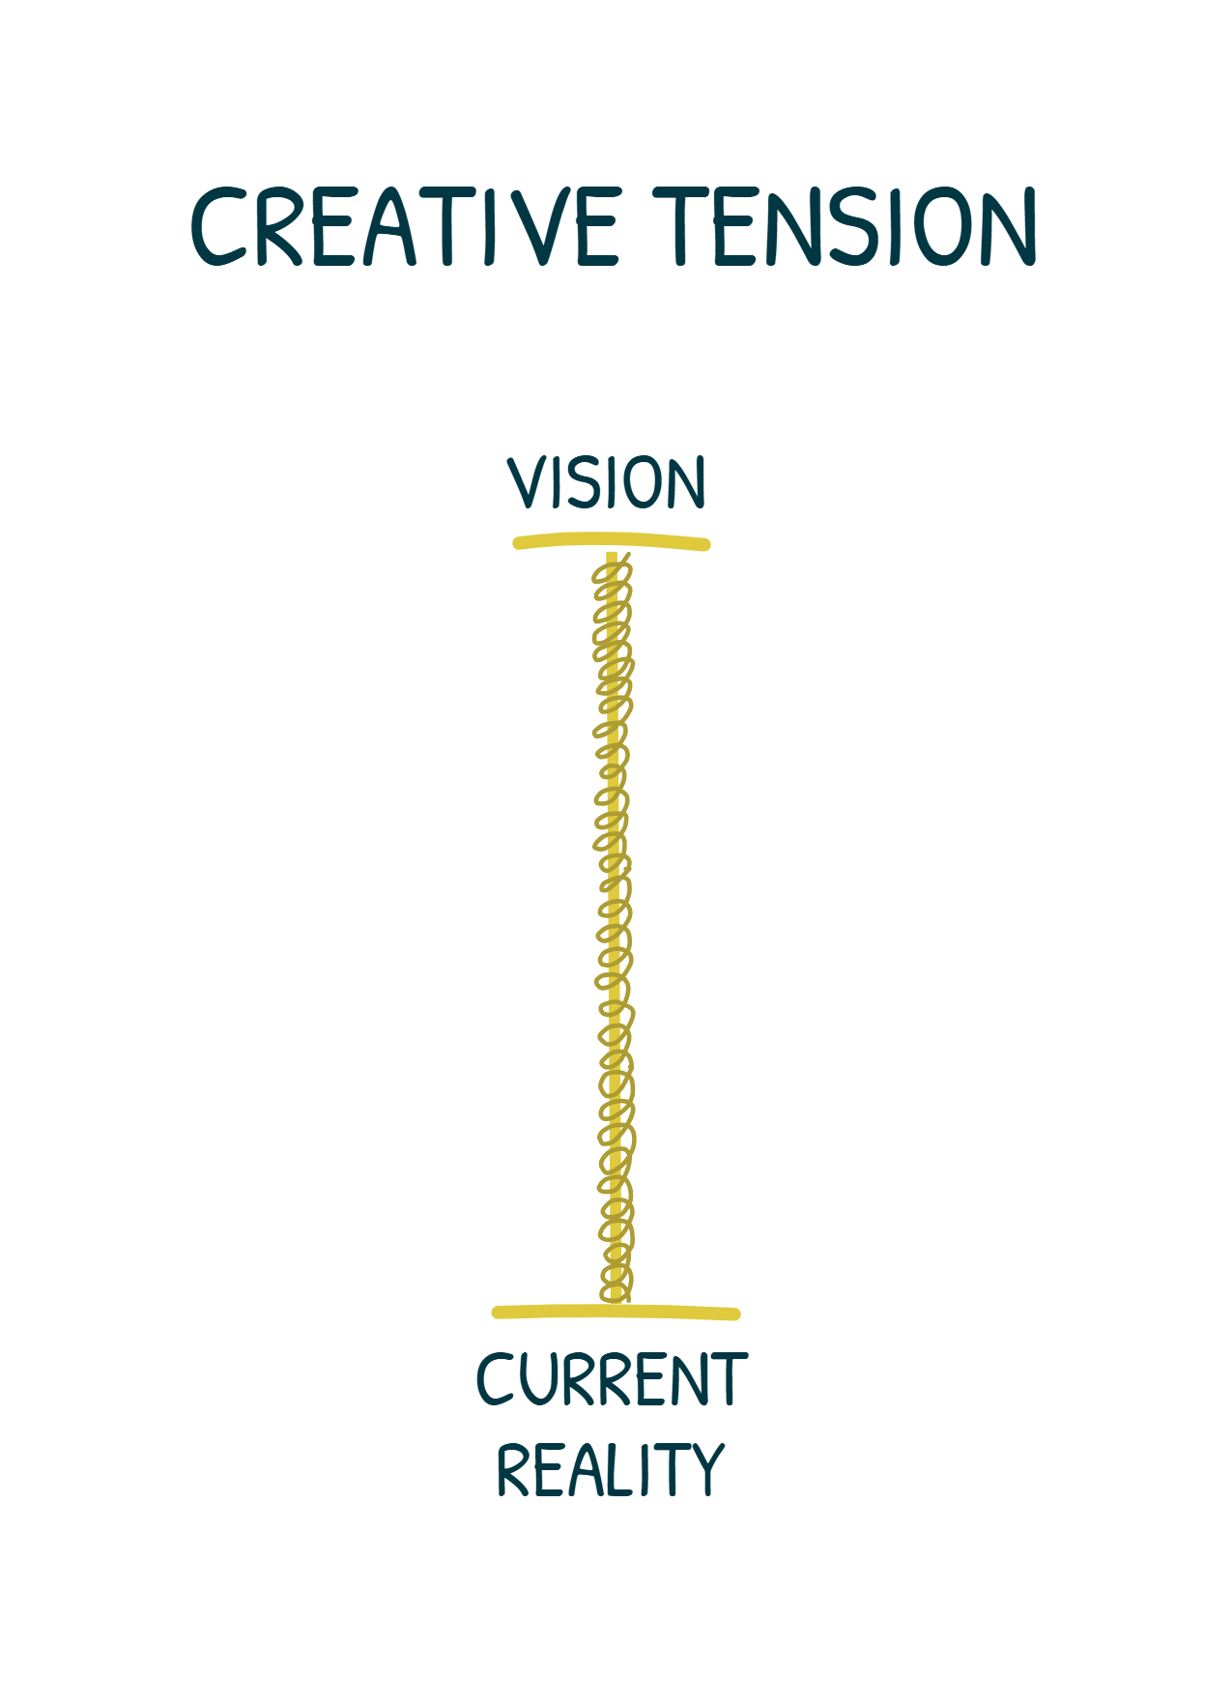
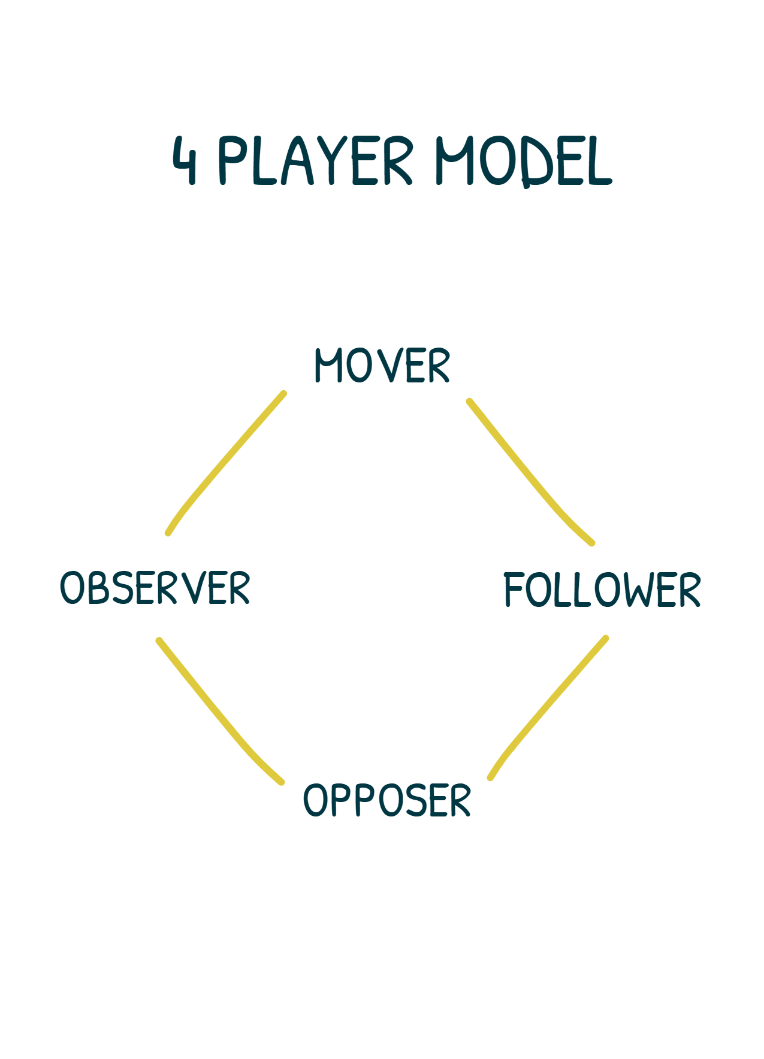
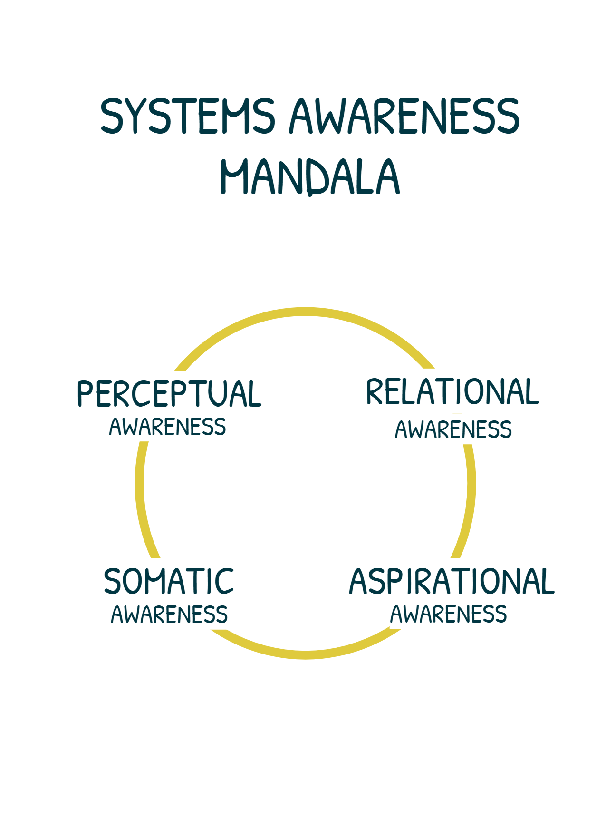
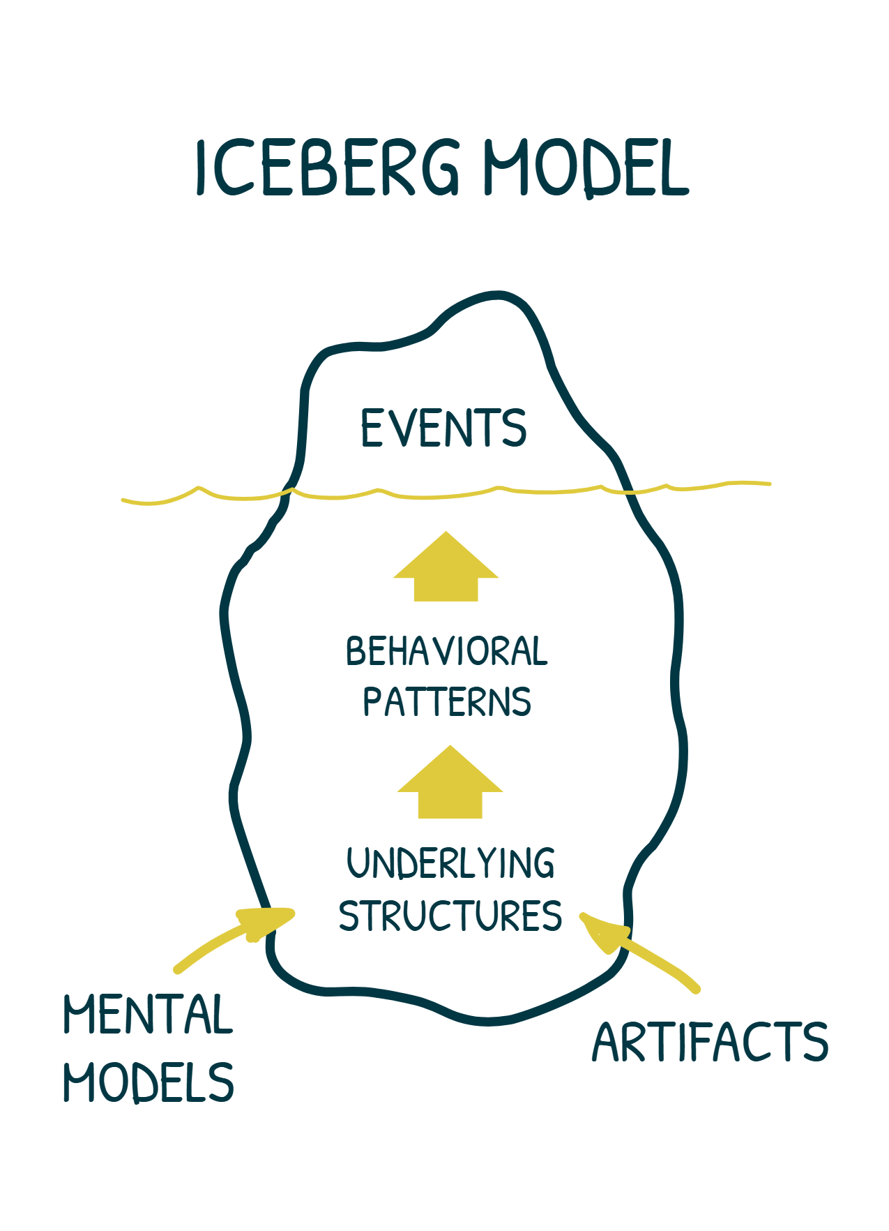
Compassionate Systems Framework
Tools and practices drawn and adapted from fields of systems dynamics, organizational learning, social emotional learning, contemplative and somatic practices.
Developed by Drs. Peter Senge, Mette Boell, and others through the independent nonprofit the Center for Systems Awareness in collaboration with MIT and others.

Slide 8
How do you make complexity accessible and fun?
How do you attend to learners’ emotional landscape when learning about climate change?
How do you inspire action?

Slide 9
Key Learning Objective
To support students in exploring the interdependencies between international climate policies, human behavior, and our individual and collective mental models and perspectives on climate effects and effective mitigation strategies.

Slide 10
dayofclimate.mit.edu
All curriculum materials are licensed
under a Creative Commons Attribution- NonCommercial 4.0 International License.

Slide 11
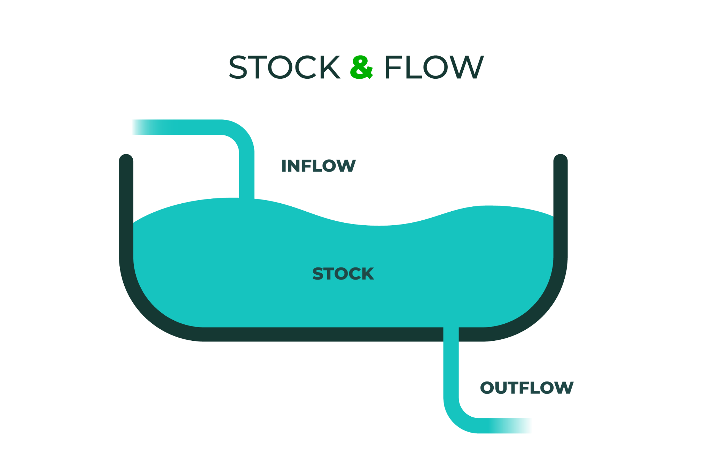
dayofclimate.mit.edu
All curriculum materials are licensed
under a Creative Commons Attribution- NonCommercial 4.0 International License.

Slide 12

dayofclimate.mit.edu

Slide 13
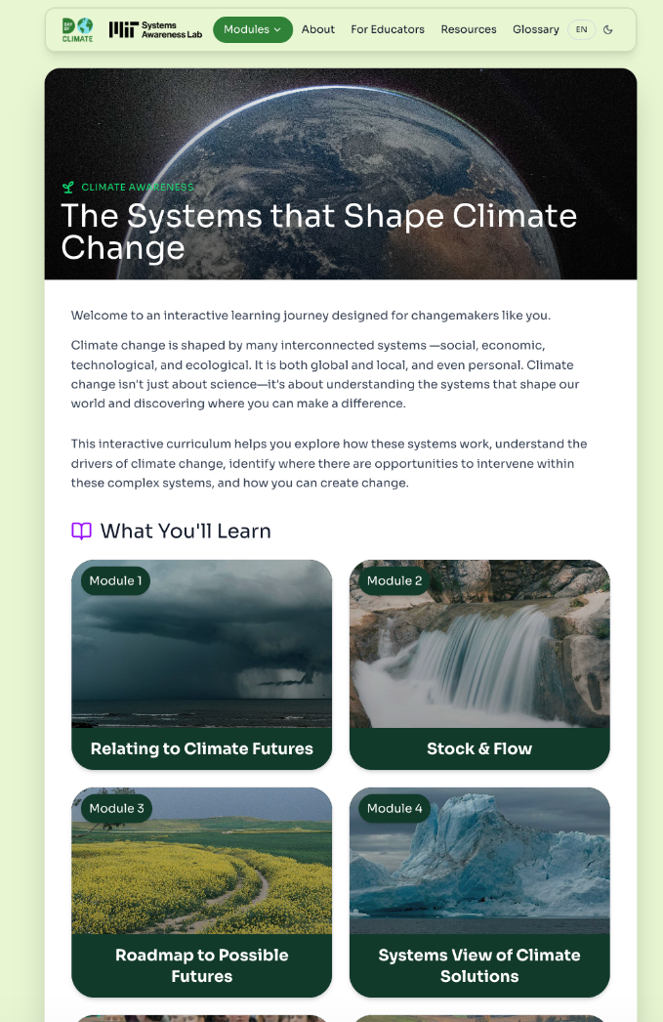
dayofclimate.mit.edu

Slide 14
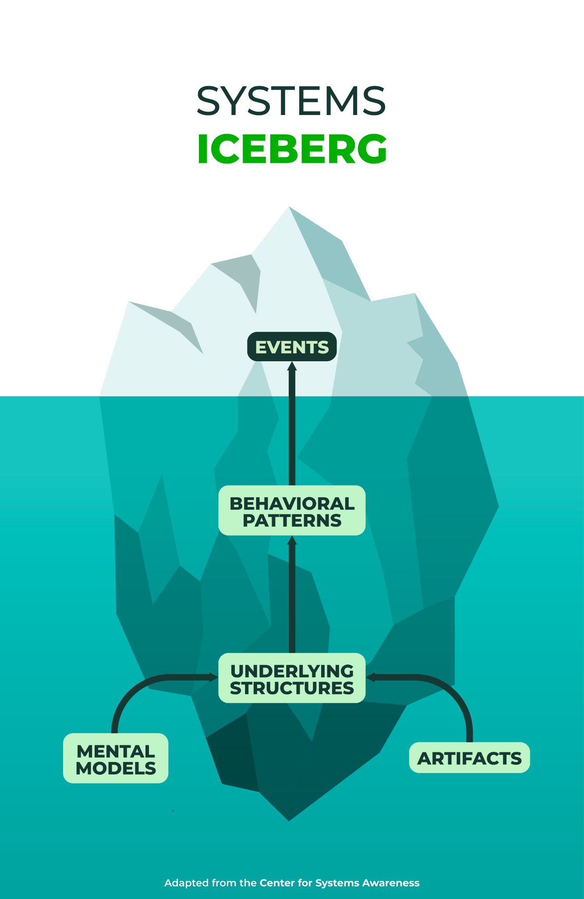
dayofclimate.mit.edu

Slide 15
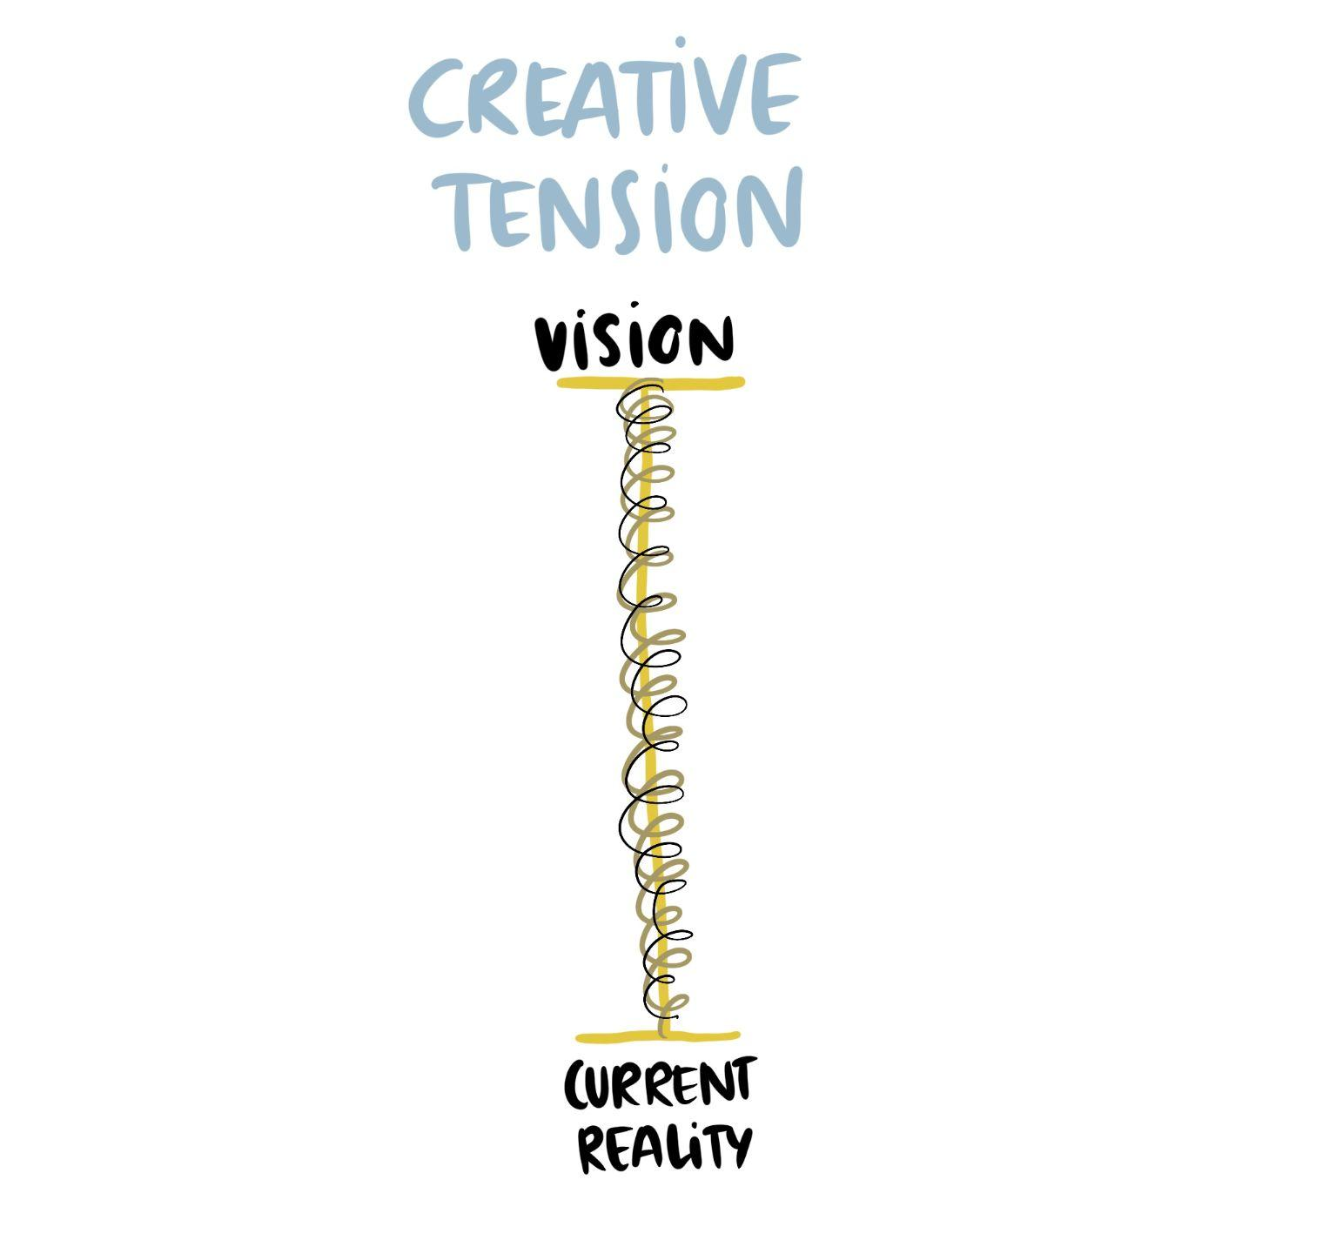
dayofclimate.mit.edu
All curriculum materials are licensed
under a Creative Commons Attribution- NonCommercial 4.0 International License.

Slide 16
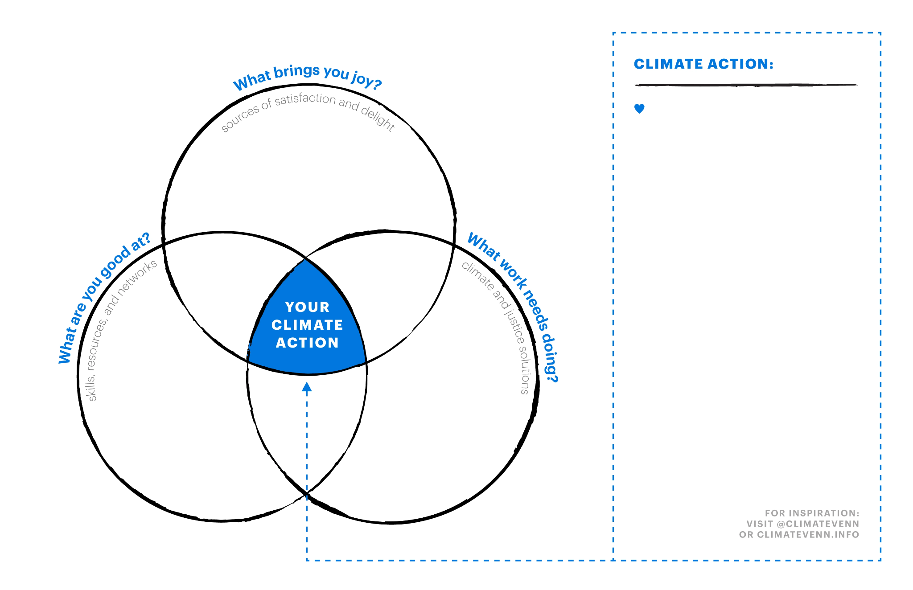

Slide 17
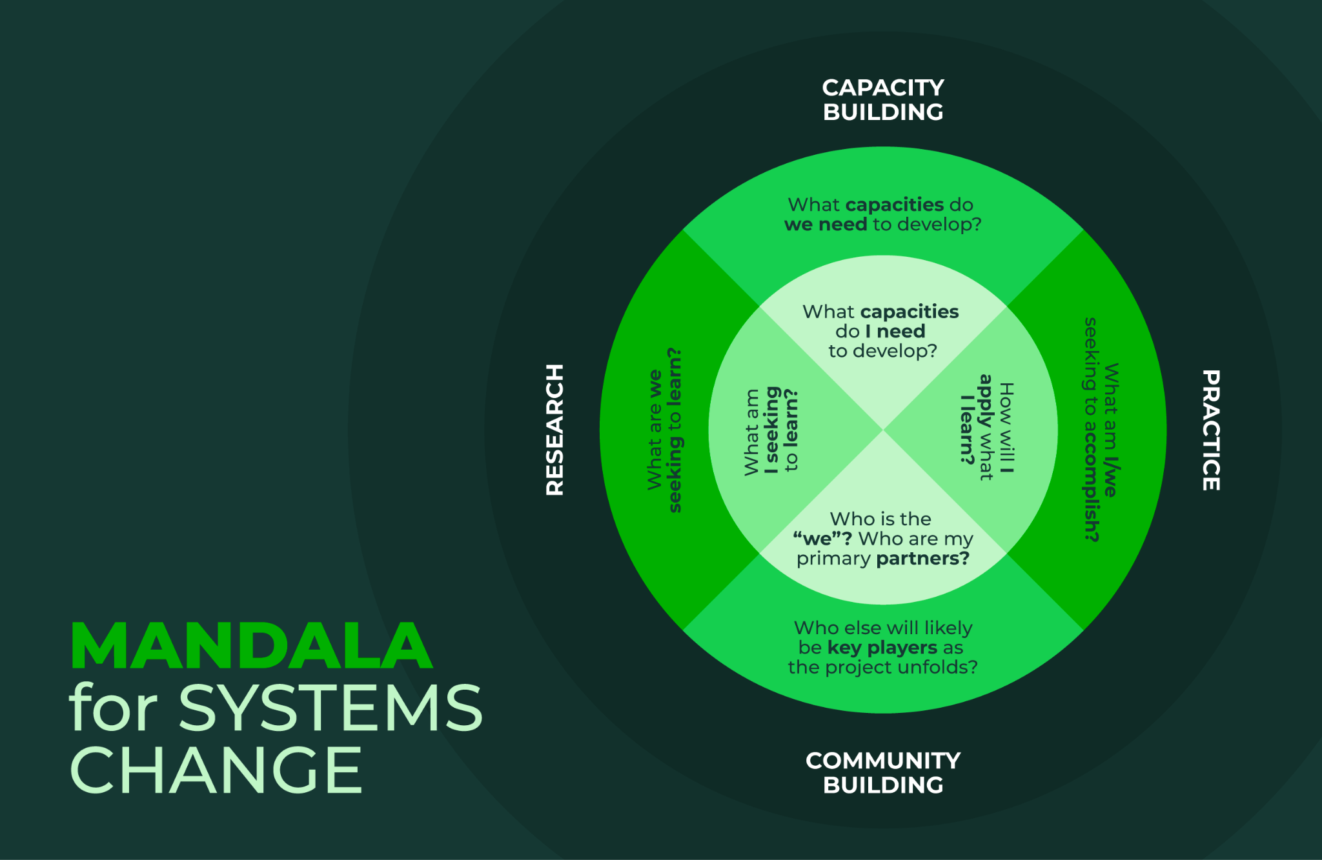

Slide 18
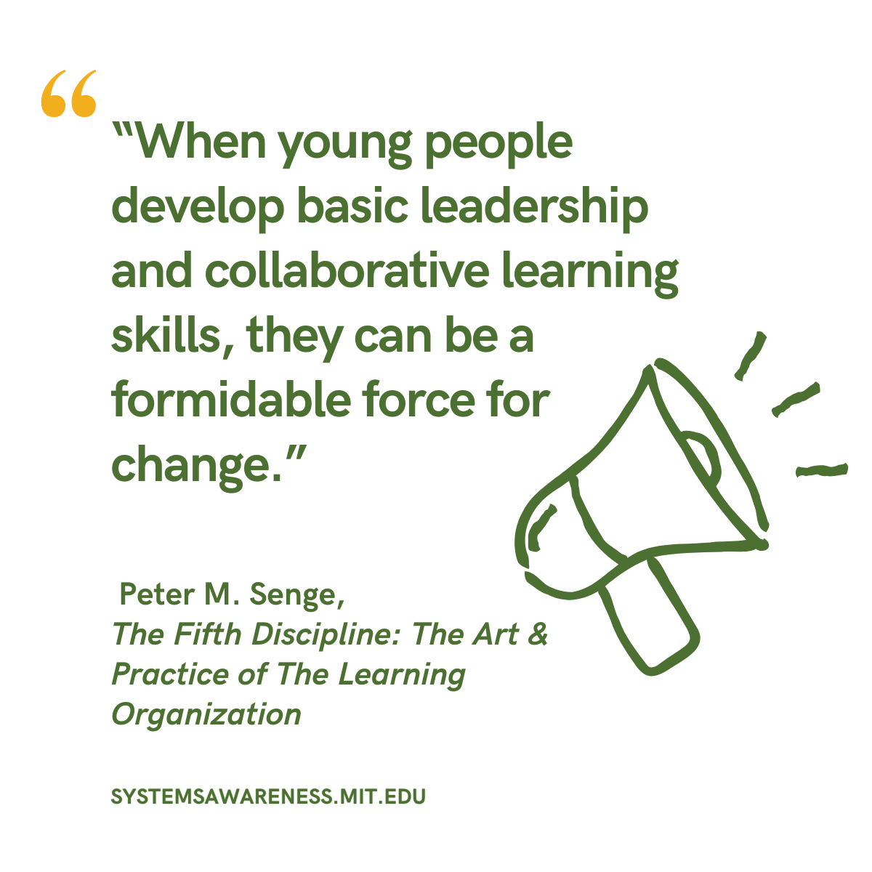

Slide 19
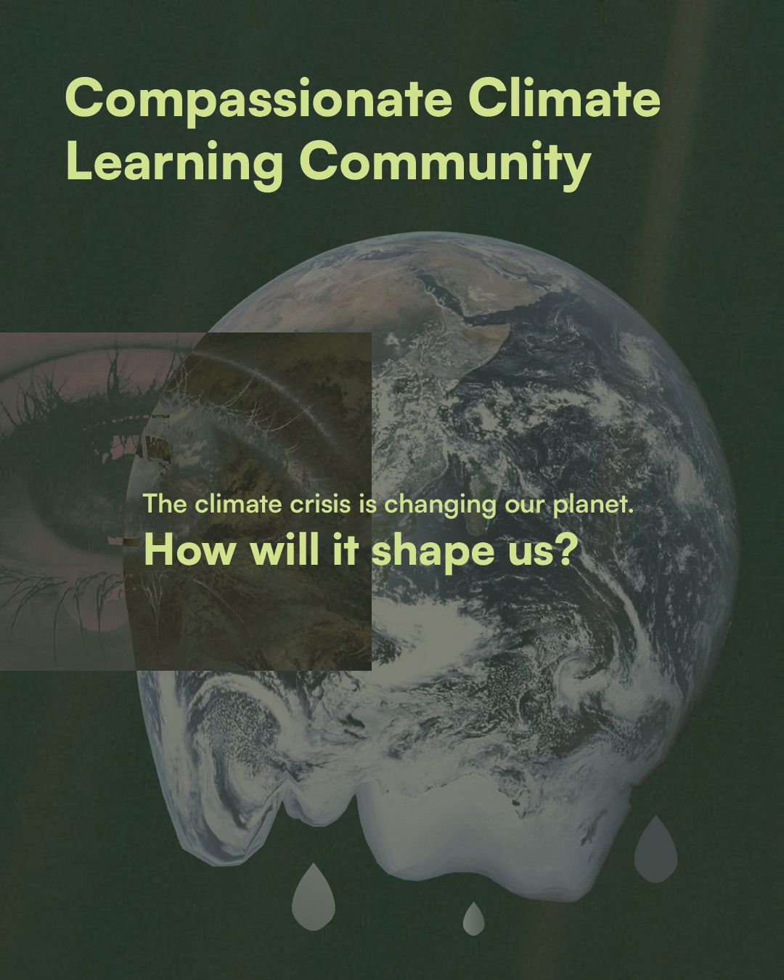
Compassionate Climate Program
September 21 - November 23, 2026
Designed, held and facilitated by the Center for Systems Awareness
Youth Leadership Team & Peter Senge
Register by August 31
systemsawareness.org/program/climate-fall2026

Slide 20
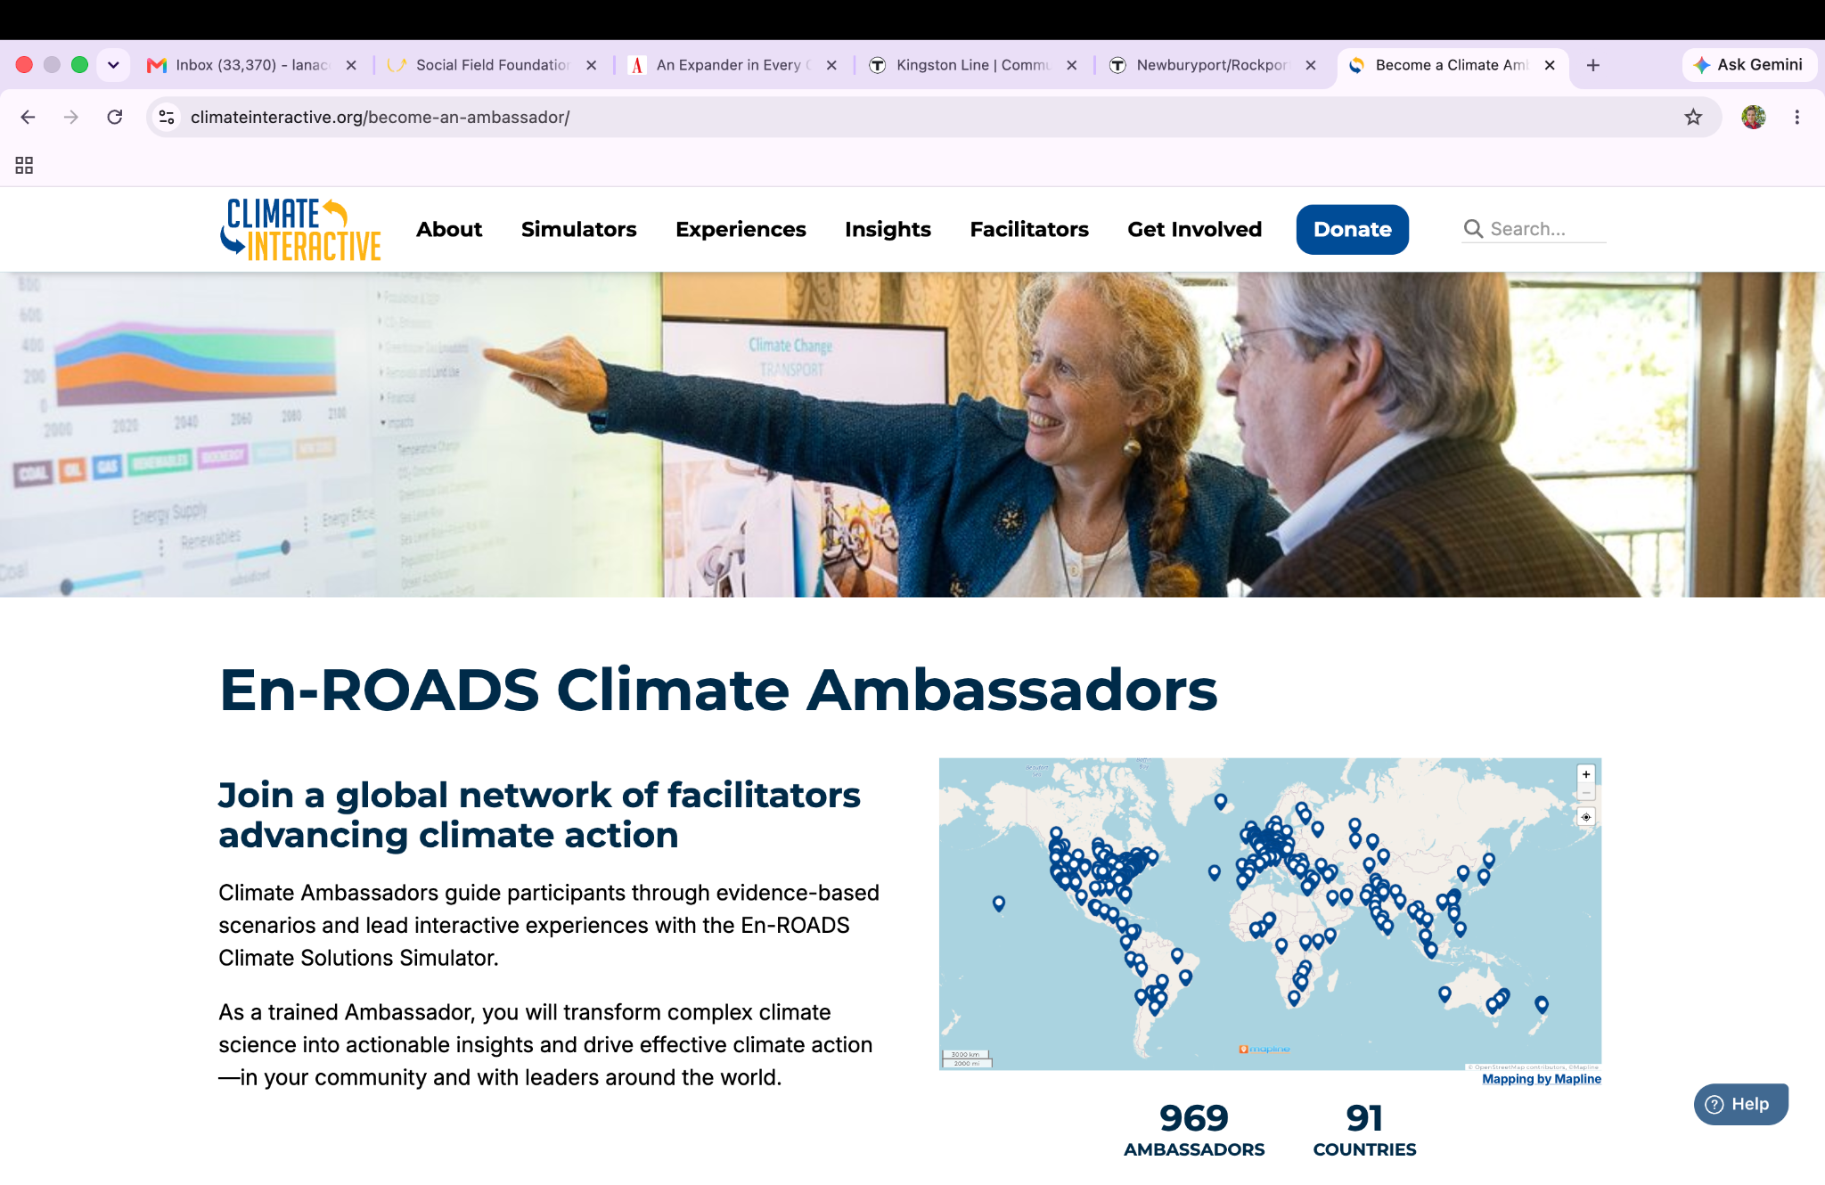

Slide 21

dayofclimate.mit.edu
To access the interactive curriculum
& educator resources, visit:
https://bit.ly/climate-mit
LanaCook@mit.edu

